Slide 1
Angular Chart and Graph Library

Slide 2
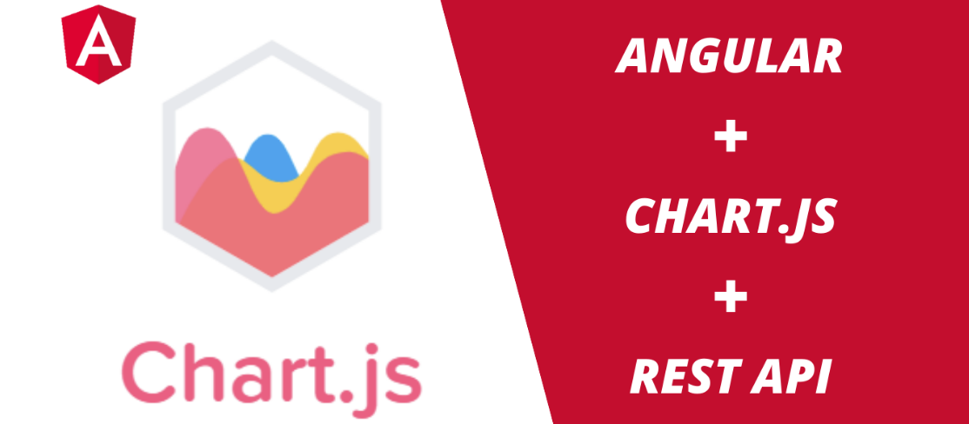

Slide 3

Chart.js
Integrate Chart.js in Angular
Integrate the REST API Form Field
Display the Data in the Chart
Demo

Slide 4
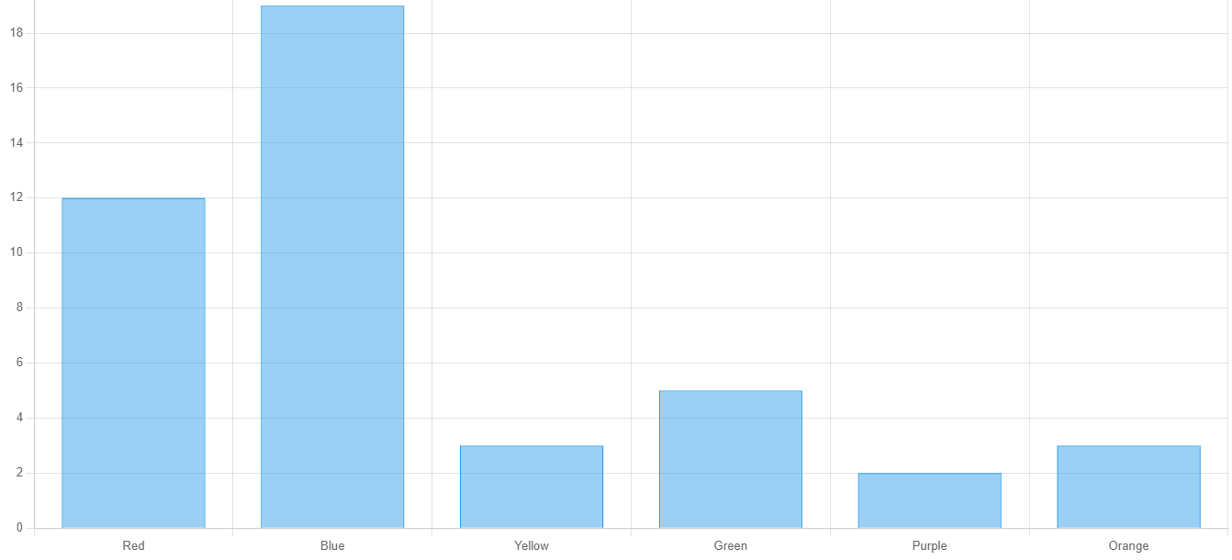
Displaying the charts with static data

Slide 5
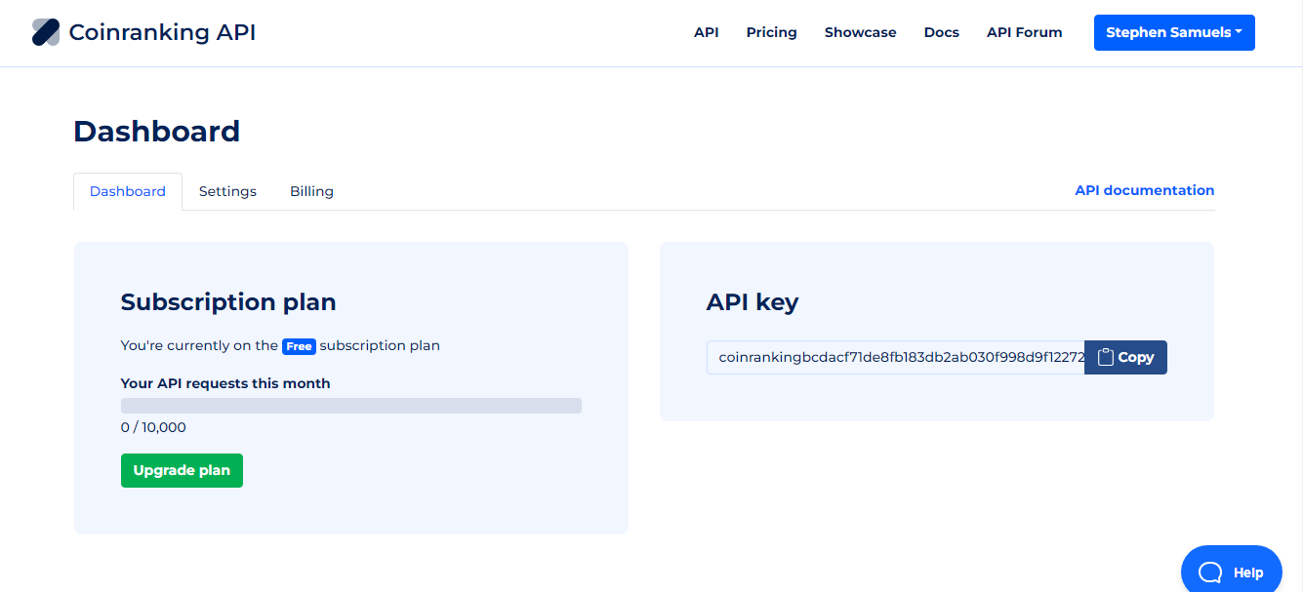

Slide 6
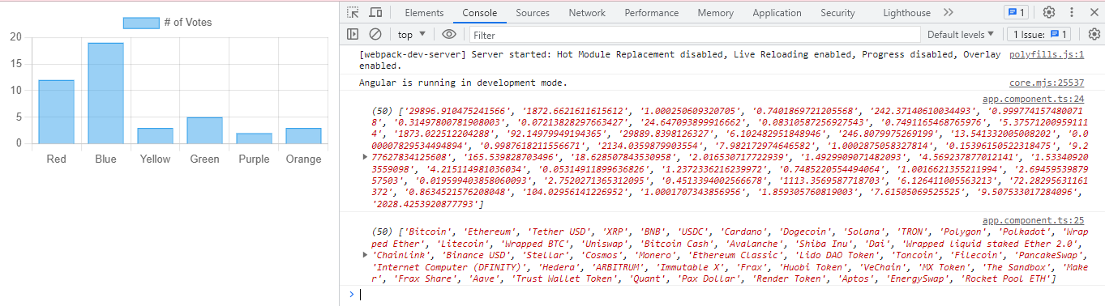
Data from the CoinRanking API displayed on the console

Slide 7
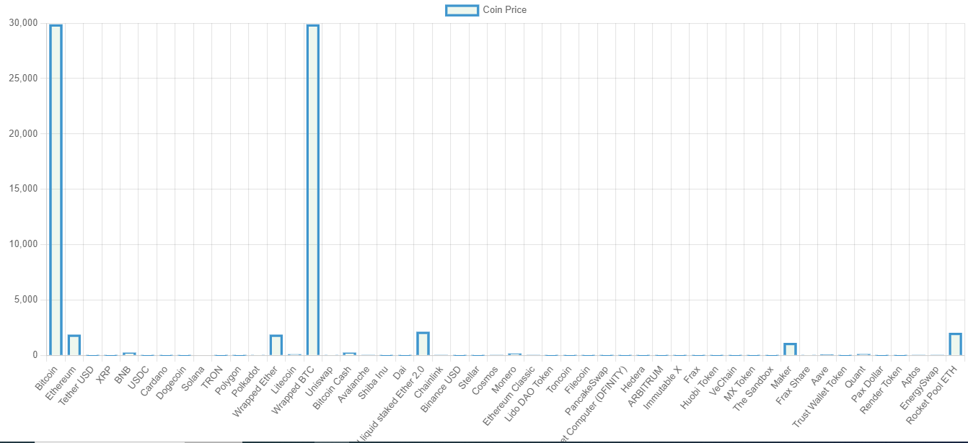
Final results of the chart

